Slide 1
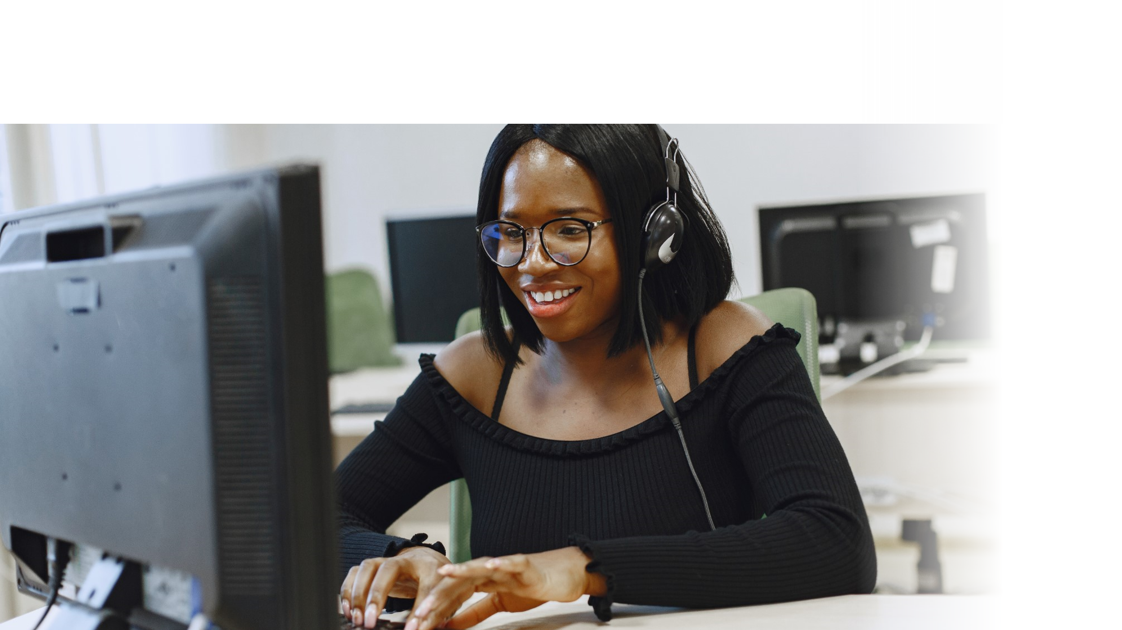



DIGITAL LITERACY
SKILLS
BASIC USERS

Slide 2
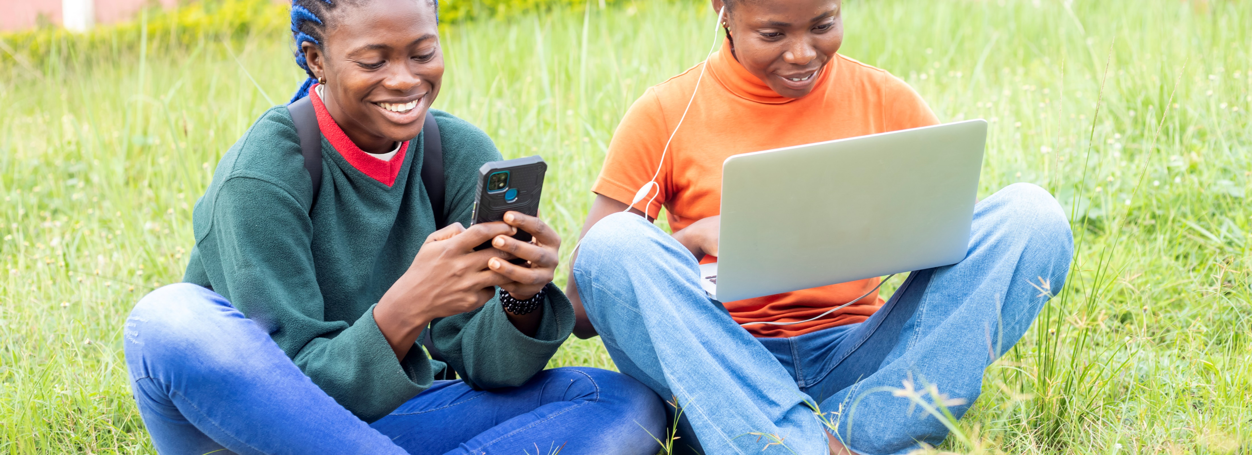
Module 5
Safety and security

Slide 3

2
Unit 2: Protecting personal data and privacy

Slide 4
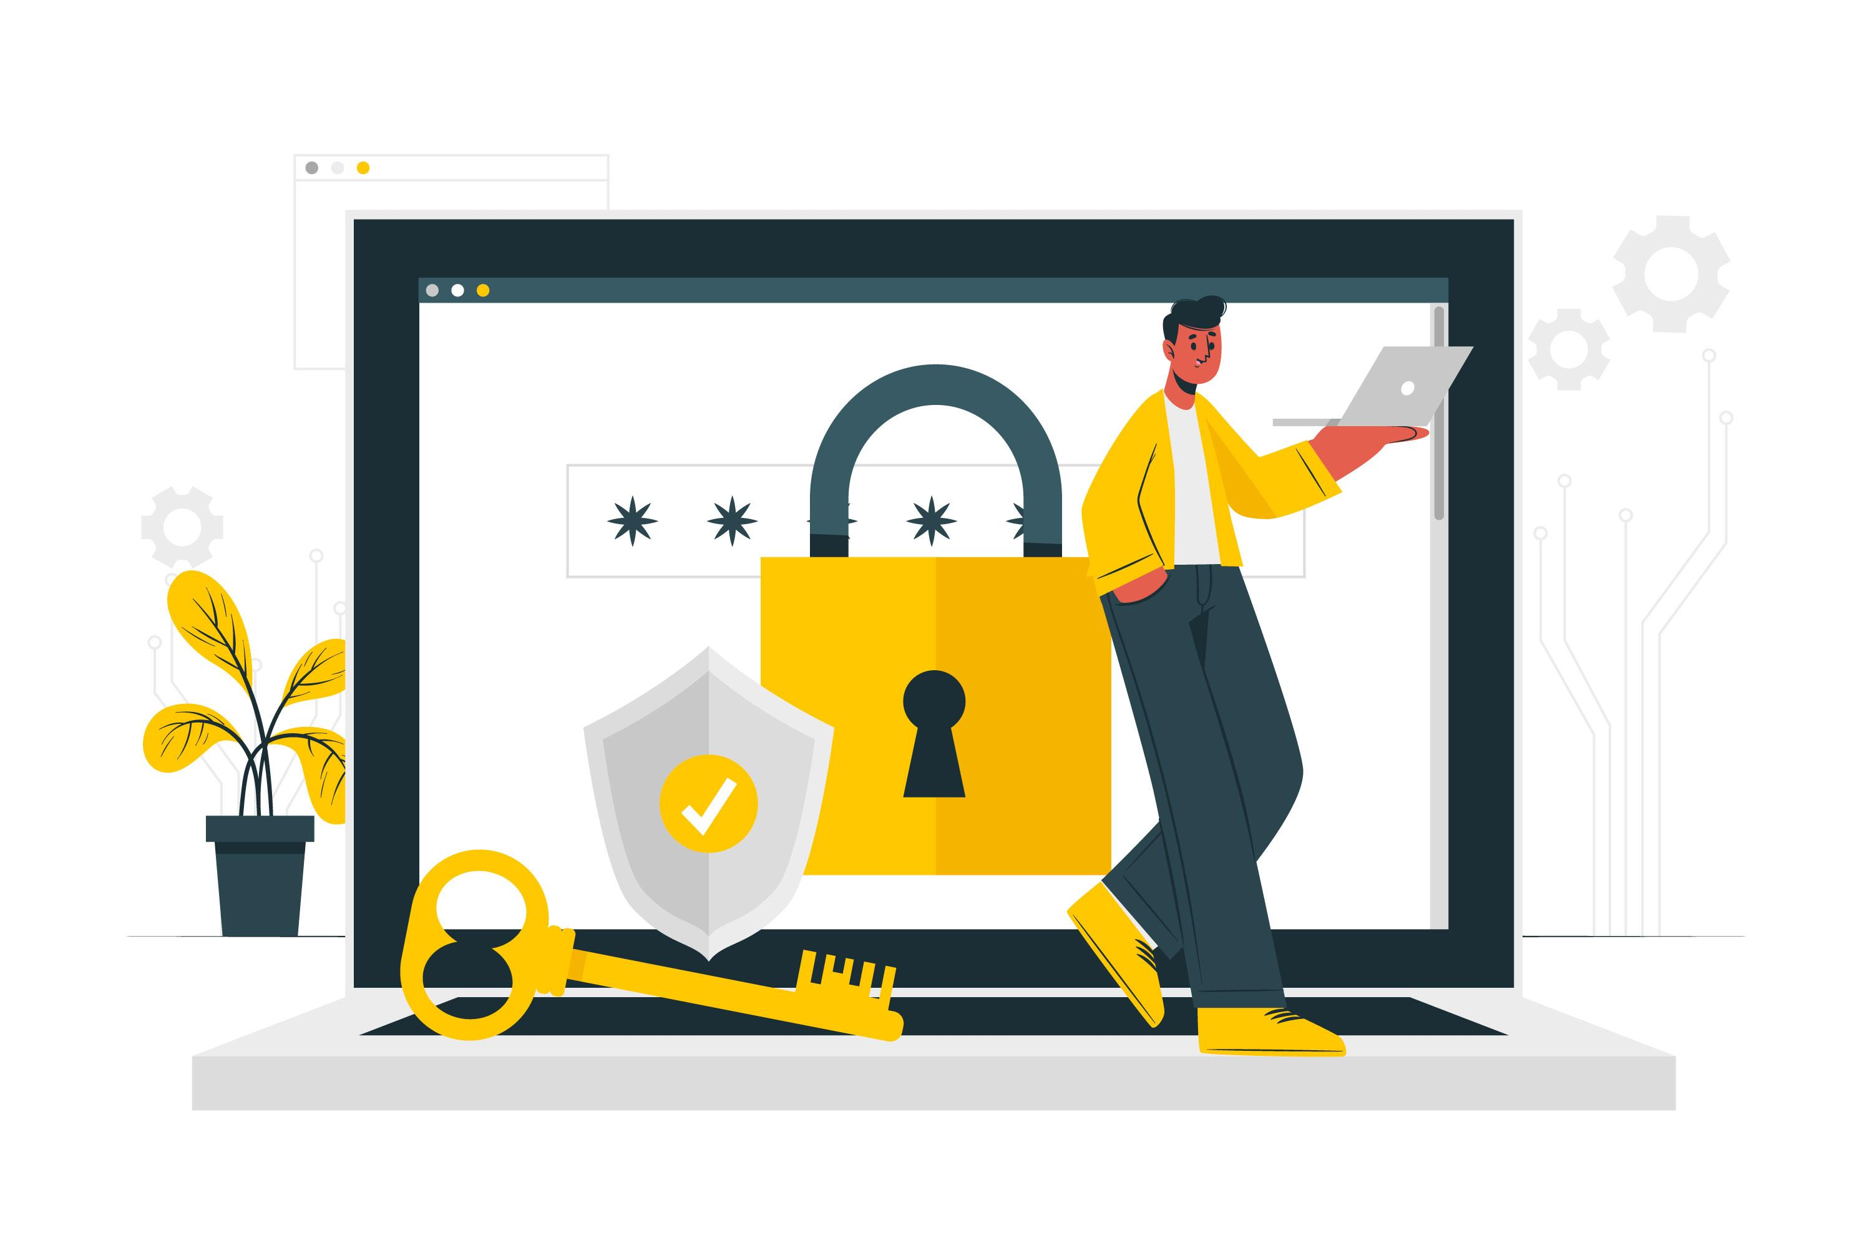
Protecting yourself online
How can you protect yourself?
Limit the amount of personal information you share.
Remember that the internet is a public resource.
Be wary of strangers.
Be sceptical.
Evaluate your settings.
Be wary of third-party applications.
Check privacy policies.

Slide 5
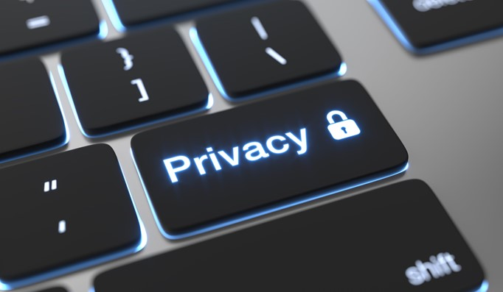
Guidelines for sharing personal information
View the internet as a novel, not a diary.
Limit the amount of personal information you post.
Realize that you cannot take it back.
You are not anonymous.

Slide 6
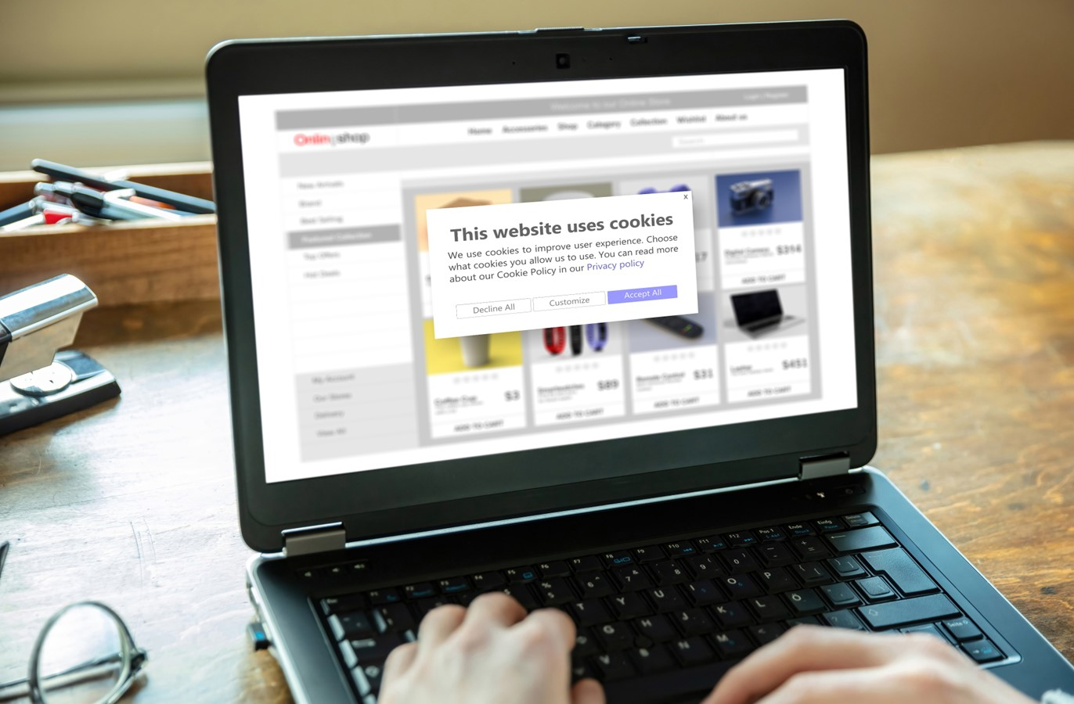
What information is collected?
When you visit a website, a certain amount of information is automatically sent to the site. This information may include the following:
IP address
Domain name
Software details
Page visits

Slide 7
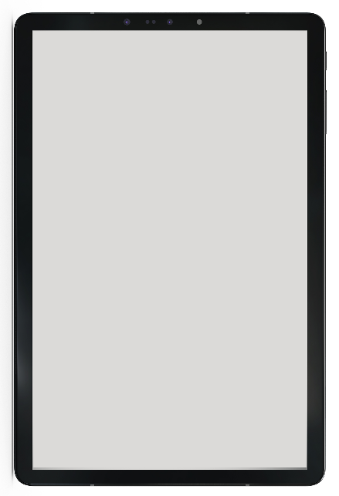
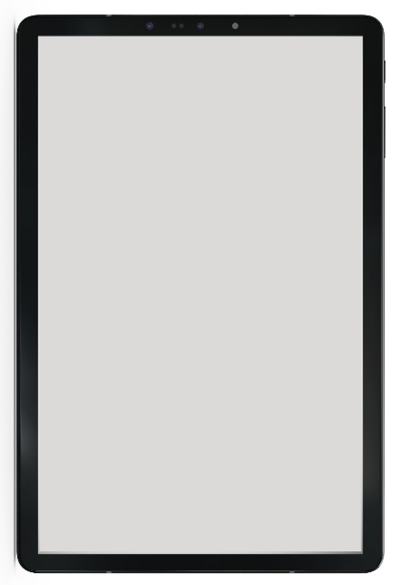
Skills to practise
Protect your personal data privacy
You receive the following messages:
Such messages are common, always check who sent the message.
Note that you will never be asked to share your login details with any legitimate digital security provider.
If you receive messages like this, never open any links or attachments as this could open your device to a virus.
Notice:
The security of your device has been compromised. To reset your security, send your current password and login and a new password to: surprize@hotmail.com
Notice:
The security of your device has been compromised. To reset your security open this attachment: http//www.surprize@hotmail.com
Continue >

Slide 8
Skills to practise
If you feel that your login details have been breached – ask your facilitator to help you change them.
If you have opened a link by mistake, inform your facilitator immediately.

Slide 9
All back covers should include
contact information of the section
producing the work.
© United Nations Children’s Fund (UNICEF) [month and year of publication]

